Slide 1
Natural Language Processing
(Lecture 1 – Introduction)
Prof. Anurag Jain
GGS Indraprastha University

Slide 2
Perpectivising NLP: Areas of AI and their inter-dependencies
Knowledge Representation
Search
Logic
Machine Learning
Planning
Expert Systems
NLP
Vision
Robotics

Slide 3
Machine Learning and NLP

Slide 4
NLP as an ML task
France beat Brazil by 1 goal to 0 in the quarter-final of the world cup football tournament. (English)
braazil ne phraans ko vishwa kap phutbal spardhaa ke kwaartaar phaainal me 1-0 gol ke baraabarii se haraayaa. (Hindi)

Slide 5
Categories of the Words in the Sentence
France beat Brazil by 1 goal to 0 in the quarter
final of the world cup football tournament
Brazil
beat
France
1
0
goal
quarter final
world cup
Football
tournament
by
to
in
the
of
function
words
content
words

Slide 6
Further Classification 1/2
Brazil
France
1
goal
0
quarter final
world cup
football
tournament
Brazil
France
Brazil
beat
France
1
goal
0
quarter final
world cup
football
tournament
proper
noun
noun
1
goal
0
quarter final
world cup
Football
tournament
verb
common
noun
beat

Slide 7
Further Classification 2/2
by
to
In
the
of
determiner
preposition
by
to
in
of
the

Slide 8
Why all this?
information need
  who did what
  to whom
  by what
  when
  where
  in what manner

Slide 9
Semantic roles
Brazil
1 goal to 0
patient/theme
France
manner
beat
agent
time
quarter
finals
world
cup
football
modifier

Slide 10
Allied Disciplines
Philosophy | Semantics, Meaning of “meaning”, Logic (syllogism)
Linguistics | Study of Syntax, Lexicon, Lexical Semantics etc.
Probability and Statistics | Corpus Linguistics, Testing of Hypotheses, System Evaluation
Cognitive Science | Computational Models of Language Processing, Language Acquisition
Psychology | Behavioristic insights into Language Processing, Psychological Models
Brain Science | Language Processing Areas in Brain
Physics | Information Theory, Entropy, Random Fields
Computer Sc. & Engg. | Systems for NLP

Slide 11
Topics to be covered
Shallow Processing
  Part of Speech Tagging and Chunking using HMM, MEMM, CRF, and Rule Based Systems
  EM Algorithm
Language Modeling
  N-grams
  Probabilistic CFGs
Basic Linguistics
  Morphemes and Morphological Processing
  Parse Trees and Syntactic Processing: Constituent Parsing and Dependency Parsing
Deep Parsing
  Classical Approaches: Top-Down, Bottom-UP and Hybrid Methods
  Chart Parsing, Earley Parsing
  Statistical Approach: Probabilistic Parsing, Tree Bank Corpora

Slide 12
Topics to be covered (contd.)
Knowledge Representation and NLP
  Predicate Calculus, Semantic Net, Frames, Conceptual Dependency, Universal Networking Language (UNL)
Lexical Semantics
  Lexicons, Lexical Networks and Ontology
  Word Sense Disambiguation
Applications
  Machine Translation
  IR
  Summarization
  Question Answering

Slide 13
What is NLP
Branch of AI
Goals
  Science Goal: Understand the language processing behaviour
  Engineering Goal: Build systems that analyse and generate language; reduce the man machine gap

Slide 14
Introduction
Only 21% of the available data is present in a structured form.
Data is being generated as we speak, as we tweet, as we send messages on WhatsApp and in various other activities.
The majority of this data exists in the textual form, which is highly unstructured in nature.

Slide 15
Despite having high dimension data, the information present in it is not directly accessible unless it is processed (read and understood) manually or analyzed by an automated system.
In order to produce significant and actionable insights from text data, it is important to get acquainted with the basics of
Natural Language Processing (NLP).

Slide 16
Techniques related to Natural Language Processing.
Corpus, Tokens, and ngrams
Tokenization
  White-space Tokenization
  Regular Expression Tokenization
Normalization
  Stemming
  Lemmatization
Part of Speech tags in NLP
Grammar in NLP and its types
  Constituency Grammar
  Dependency Grammar

Slide 17
Corpus, Tokens, and Engrams
A Corpus is defined as a collection of text documents for example a data set containing news is a corpus or the tweets containing Twitter data is a corpus.
Corpus consists of documents, documents comprise paragraphs, paragraphs comprise sentences and sentences comprise further smaller units which are called Tokens.

Slide 18
Tokens
Tokens can be words, phrases, or Engrams
Engrams are defined as the group of n words together.
For example, consider this given sentence-
“I love my phone.”
In this sentence, the uni-grams(n=1) are: I, love, my, phone
Di-grams( Bi-grams) (n=2) are: I love, love my, my phone
And tri-grams(n=3) are: I love my, love my phone
So, uni-grams are representing one word, di-grams are representing two words together and tri-grams are representing three words together.

Slide 19
Tokenization
Tokenization is a process of splitting a text object into smaller units which are also called tokens.
Examples of tokens can be words, numbers, engrams, or even symbols.
The most commonly used tokenization process is White-space Tokenization.

Slide 20
White-space Tokenization
Also known as unigram tokenization.
In this process, the entire text is split into words by splitting them from white spaces.
For example, in a sentence- “I went to New-York to play football.”
splitted into following tokens: “I”, “went”, “to”, “New-York”, “to”, “play”, “football.”
Notice that “New-York” is not split further because the tokenization process was based on whitespaces only.

Slide 21
Regular Expression Tokenization
Regular expression pattern is used to get the tokens.
For example, consider the following string containing multiple delimiters such as comma, semi-colon, and white space.
Tokens= “Football”, ”Cricket”, “Golf”, “Tennis”
Using Regular expression, we can split the text by passing a splitting pattern.
Tokenization can be performed at the sentence level or at the word level or even at the character level
Sentence= “Football, Cricket; Golf Tennis"
re.split(r’[;,\s]’, Sentence

Slide 22
Normalization
In the field of linguistics and NLP, a Morpheme is defined as the base form of a word.
A token is generally made up of two components, Morphemes, which are the base form of the word, and Inflectional forms, which are essentially the suffixes and prefixes added to morphemes.
For example, consider the word Antinationalist,
-made up of Anti and ist as the inflectional forms and national as the morpheme.

Slide 23
Normalization
Normalization is the process of converting a token into its base form.
In the normalization process, the inflection from a word is removed so that the base form can be obtained.
So, the normalized form of anti-nationalist is national.
Useful in
  reducing the number of unique tokens present in the text,
  removing the variations of a word in the text, and
  removing redundant information too.
  Popular methods which are used for normalization are Stemming and Lemmatization.

Slide 24
Stemming
Stemming is an elementary rule-based process for removing inflectional forms from a token and the outputs are the stem of the word.
For example, “laughing”, “laughed“, “laughs”, “laugh” will all become “laugh”, which is their stem, because their inflection form will be removed.

Slide 25

Stemming
Stemming is not a good normalization process because sometimes stemming can produce words that are not in the dictionary. For example, consider a sentence:
“His teams are not winning”
After stemming the tokens that we will get are- “hi”, “team”, “are”, “not”, “winn”
Notice that the keyword “winn” is not a regular word and “hi” changed the context of the entire sentence.
Another example –

Slide 26
Lemmatization
Systematic step-by-step process for removing inflection forms of a word.
It makes use of
  vocabulary,
  word structure,
  part of speech tags, and
  grammar relations.
The output of lemmatization is the root word called a lemma.
For example,
Am, Are, Is >> Be
Running, Ran, Run >> Run

Slide 27
Since it is a systematic process while performing lemmatization one can specify the part of the speech tag for the desired term and lemmatization will only be performed if the given word has the proper part of the speech tag.
For example, if we try to lemmatize the word running as a verb, it will be converted to run. But if we try to lemmatize the same word running as a noun it won’t be converted.

Slide 28
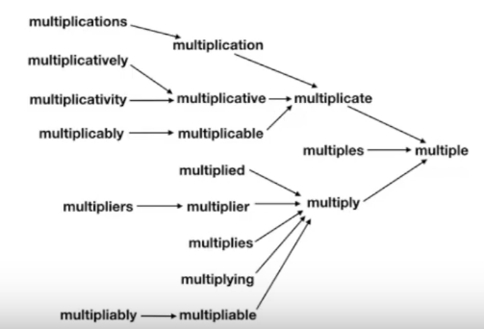
Step-by-step process of Lemmatization to remove inflection forms

Slide 29
syntax and structure-related properties of text objects
Part of speech tags
Grammar.

Slide 30
Part of Speech(PoS) Tags in Natural Language Processing-
Noun
Pronoun
Verb
Adjective
Adverb
Conjunction
Preposition
Interjection

Slide 31
Part of speech tags or PoS tags
Properties of words that define their
  main context,
  function,
  usage in a sentence.
Some of the commonly used parts of speech tags are-
  Nouns, which define any object or entity;
  Verbs, which define some action; and
  Adjectives or Adverbs, which act as the modifiers, quantifiers, or intensifiers in any sentence.
  In a sentence, every word will be associated with a proper part of the speech tag,

Slide 32
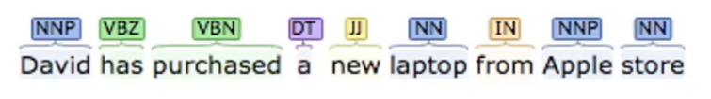
Example of PoS
“David has purchased a new laptop from the Apple store.”
David’ has NNP tag-proper noun
“has” and “purchased” - verb indicating that they are the actions
“laptop” and “Apple store” –nouns
“new” is the adjective whose role is to modify the context of laptop.

Slide 33
Part of speech tags
Defined by the relations of words with the other words in the sentence.
Machine learning models or rule-based models are applied to obtain the part of speech tags of a word.
The most commonly used part of speech tagging notations is provided by the Penn Part of Speech Tagging.

Slide 34
Penn Part of Speech Tags
1. CC Coordinating conjunction | 2. CD Cardinal number | 3. DT Determiner | 4. EX Existential there | 5. FW Foreign word
6. IN Preposition or subordinating conjunction | 7. JJ Adjective | 8. JJR Adjective, comparative | 9. JJS Adjective, superlative | 10. LS List item marker
11. MD Modal | 12. NN Noun, singular or mass | 13. NNS Noun, plural | 14. NNP Proper noun, singular | 15. NNPS Proper noun, plural
16. PDT Predeterminer | 17. POS Possessive ending | 18. PRP Personal pronoun | 19. PRP$ Possessive pronoun | 20. RB Adverb
21. RBR Adverb, comparative | 22. RBS Adverb, superlative | 23. RP Particle | 24. SYM Symbol | 25. TO to
26. UH Interjection 27. VB Verb, base form | 28. VBD Verb, past tense | 29. VBG Verb, gerund or present participle | 30. VBN Verb, past participle | 31. VBP Verb, non-3rd person singular present
32. VBZ Verb, 3rd person singular present | 33. WDT Wh-determiner | 34. WP Wh-pronoun | 35. WP$ Possessive wh-pronoun | 36. WRB Wh-adverb

Slide 35
Aplplication of PoS tags
Variety of tasks such as
  text cleaning,
  feature engineering tasks, and
  word sense disambiguation.
Sentence 1: “Please book my flight for NewYork”
Sentence 2: “I like to read a book on NewYork”
In both sentences, the keyword “book” is used but in sentence one, it is used as a verb while in sentence two it is used as a noun.

Slide 36
Grammar in NLP and its types
Grammar refers to the rules for forming well-structured sentences.
The first type of Grammar is Constituency grammar.
The second type of grammar is Dependency Grammar

Slide 37
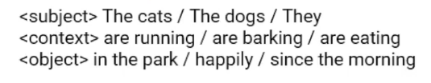
Constituency Grammar
Any word, group of words, or phrases can be termed as Constituents
goal of constituency grammar is to organize any sentence into its constituents using their properties.
These properties are generally driven by their part of speech tags, noun or verb phrase identification.
For example, constituency grammar can define that any sentence can be organized into three constituents- a subject, a context, and an object.

Slide 38

Another view to look at constituency grammar
Define their grammar in terms of their part of speech tags.
Say a grammar structure containing a
[determiner, noun] [ adjective, verb] [preposition, determiner, noun] which corresponds to the same sentence-
“The dogs are barking in the park.”

Slide 39
Dependency Grammar
Words of a sentence are dependent upon other words of the sentence.
For example, in the previous sentence “barking dog” was mentioned and the dog was modified by barking as the dependency adjective modifier exists between the two.
Dependency grammar organizes the words of a sentence according to their dependencies.
One of the words in a sentence acts as a root and all the other words are directly or indirectly linked to the root using their dependencies.
These dependencies represent relationships among the words in a sentence and dependency grammars are used to infer the structure and semantics dependencies between the words.

Slide 40
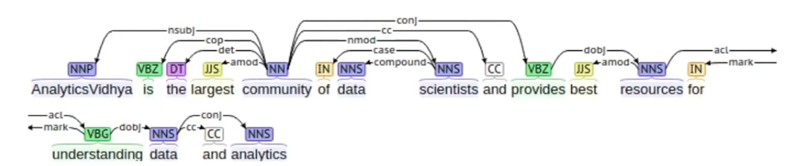
Example
The dependency tree of this sentence looks something like this-
In this tree, the root word is “community” having NN as the part of speech tag and every other word of this tree is connected to root, directly or indirectly, with a dependency relation such as a direct object, direct subject, modifiers, etc.

Slide 41

These relationships define their roles and functions of each word in the sentence and how multiple words are connected together. Every dependency can be represented in the form of a triplet which contains a governor, a relation, and a dependent
Dependent is connected to the governor by relation, or in other words, they are subject, verb, and object respectively.
“Analytics Vidhya” is the subject and is playing the role of a governor, the verb here is “is” and is playing the role of the relation, and “the largest community of data scientist” is the dependent or the object.

Slide 42
Application of D. Grammar
Named Entity Recognition– they are used to solve named entity recognition problems.
Question Answering System– they can be used to understand relational and structural aspects of question-answering systems.
Coreference Resolution– they are also used in coreference resolutions in which the task is to map the pronouns to the respective noun phrases.
Text summarization and Text classification– they can also be used for text summarization problems and they are also used as features for text classification problems.

Slide 46
“What is it” question: NLP is concerned with Grounding
Ground the language into perceptual, motor and cognitive capacities.

Slide 47

Grounding
Chair
Computer

Slide 48
Grounding faces 3 challenges
Ambiguity. A word may have different meaning
Co-reference resolution (anaphora is a kind of it).
  the use of a word referring back to a word used earlier in a text or conversation, to avoid repetition, for example the pronouns he, she, it, and they and the verb do in I like it and so do they.
Ellipsis.- an ellipsis is the omission of one or more words, which must be supplied by the listener or reader for the sentence to be understood.
  Eg- "Sounds logical.“ (Where is Noun??)

Slide 49

Ambiguity
Chair

Slide 50
Co-reference Resolution
Sequence of commands to the robot:
Place the wrench on the table.
Then paint it.
What does it refer to?

Slide 51
Elipsis
Sequence of command to the Robot:
Move the table to the corner.
Also the chair.
Second command needs completing by using the first part of the previous command.

Slide 52
Two Views of NLP and the Associated Challenges
Classical View
Statistical/Machine Learning View

Slide 53
Stages of processing (traditional view)
Phonetics and phonology
Morphology
Lexical Analysis
Syntactic Analysis
Semantic Analysis
Pragmatics
Discourse

Slide 54
Phonetics
Processing of speech
Challenges
  Homophones: bank (finance) vs. bank (river
  bank)
  Near Homophones: maatraa vs. maatra (hin)
  Word Boundary
    aajaayenge (aa jaayenge (will come) or aaj aayenge (will come today)
    I got [ua]plate
  Phrase boundary
    mtech1 students are especially exhorted to attend as such seminars are integral to one's post-graduate education
  Disfluency: ah, um, ahem etc.

Slide 55
Morphology
Word formation rules from root words
Nouns: Plural (boy-boys); Gender marking (czar-czarina)
Verbs: Tense (stretch-stretched); Aspect (e.g. perfective sit-had sat); Modality (e.g. request khaanaa→ khaaiie)
First crucial first step in NLP
Languages rich in morphology: e.g., Dravidian, Hungarian, Turkish
Languages poor in morphology: Chinese, English
Languages with rich morphology have the advantage of easier processing at higher stages of processing
A task of interest to computer science: Finite State Machines for Word Morphology

Slide 56
Lexical Analysis
Essentially refers to dictionary access and obtaining the properties of the word
e.g. dog
noun (lexical property)
take-’s’-in-plural (morph property)
animate (semantic property)
4-legged (-do-)
carnivore (-do)
Challenge: Lexical or word sense disambiguation

Slide 57
Lexical Disambiguation
First step: part of Speech Disambiguation
    Dog as a noun (animal)
    Dog as a verb (to pursue)
Sense Disambiguation
    Dog (as animal)
    Dog (as a very detestable person)
Needs word relationships in a context
    The chair emphasised the need for adult education
    Very common in day to day communications
    Satellite Channel Ad: Watch what you want, when you want (two senses of watch)
    e.g., Ground breaking ceremony/research

Slide 58
Technological developments bring in new terms, additional meanings/nuances for existing terms
  Justify as in justify the right margin (word processing context)
  Xeroxed: a new verb
  Digital Trace: a new expression

Slide 59
Syntax Processing Stage
Structure Detection
S
VP
NP
V
NP
I
like
mangoes

Slide 60
Parsing Strategy
Driven by grammar
    S-> NP VP
    NP-> N | PRON
    VP-> V NP | V PP
    N-> Mangoes
    PRON-> I
    V-> like

Slide 61
Challenges in Syntactic Processing: Structural Ambiguity
Scope
    1.The old men and women were taken to safe locations
    (old men and women) vs. ((old men) and women)
    2. No smoking areas will allow Hookas inside
Preposition Phrase Attachment
    I saw the boy with a telescope
    (who has the telescope?)
    I saw the mountain with a telescope
    (world knowledge: mountain cannot be an instrument of seeing)
    I saw the boy with the pony-tail
    (world knowledge: pony-tail cannot be an instrument of seeing)
    Very ubiquitous: newspaper headline “20 years later, BMC pays father 20 lakhs for causing son’s death”

Slide 62
Structural Ambiguity…
Overheard
  I did not know my PDA had a phone for 3 months
An actual sentence in the newspaper
  The camera man shot the man with the gun when he was near Tendulkar

Slide 63
Machine Learning and NLP

Slide 64
NLP as an ML task
France beat Brazil by 1 goal to 0 in the quarter-final of the world cup football tournament. (English)
braazil ne phraans ko vishwa kap phutbal spardhaa ke kwaartaar phaainal me 1-0 gol ke baraabarii se haraayaa. (Hindi)

Slide 65
Categories of the Words in the Sentence
France beat Brazil by 1 goal to 0 in the quarter
final of the world cup football tournament
Brazil
beat
France
1
0
goal
quarter final
world cup
Football
tournament
by
to
in
the
of
function
words
content
words

Slide 66
Further Classification 1/2
Brazil
France
1
goal
0
quarter final
world cup
football
tournament
Brazil
France
Brazil
beat
France
1
goal
0
quarter final
world cup
football
tournament
proper
noun
noun
1
goal
0
quarter final
world cup
Football
tournament
verb
common
noun
beat

Slide 67
Further Classification 2/2
by
to
In
the
of
determiner
preposition
by
to
in
of
the

Slide 68
Why all this?
information need
  who did what
  to whom
  by what
  when
  where
  in what manner

Slide 69
Semantic roles
Brazil
1 goal to 0
patient/theme
France
manner
beat
agent
time
quarter
finals
world
cup
football
modifier

Slide 70
Semantic Role Labeling: a classification task
France beat Brazil by 1 goal to 0 in the quarter-final of the world cup football tournament
  Brazil: agent or object?
  Agent: Brazil or France or Quarter Final or World Cup?
Given an entity, what role does it play?
Given a role, it is played by which entity?

Slide 71
A lower level of classification: Part of Speech (POS) Tag Labeling
France beat Brazil by 1 goal to 0 in the quarter-final of the world cup football tournament
  beat: verb or noun (heart beat, e.g.)?
  Final: noun or adjective?

Slide 72
Uncertainty in classification: Ambiguity
Visiting aunts can be a nuisance
  Visiting:
    adjective or gerund (POS tag ambiguity)
  Role of aunt:
    agent of visit (aunts are visitors)
    object of visit (aunts are being visited)
Minimize uncertainty of classification with cues from the sentence

Slide 73
What cues?
Position with respect to the verb:
  France to the left of beat and Brazil to the right: agent-object role marking (English)
Case marking:
  France ne (Hindi); ne (Marathi): agent role
  Brazil ko (Hindi); laa (Marathi): object role
Morphology: haraayaa (hindi); haravlaa (Marathi):
  verb POS tag as indicated by the distinctive suffixes

Slide 74
Cues are like attribute-value pairs prompting machine learning from NL data
Constituent ML tasks
  Goal: classification or clustering
  Features/attributes (word position, morphology, word label etc.)
  Values of features
  Training data (corpus: annotated or un-annotated)
  Test data (test corpus)
  Accuracy of decision (precision, recall, F-value, MAP etc.)
  Test of significance (sample space to generality)

Slide 75
What is the output of an ML-NLP System (1/2)
Option 1: A set of rules, e.g.,
  If the word to the left of the verb is a noun and has animacy feature, then it is the likely agent of the action denoted by the verb.
    The child broke the toy (child is the agent)
    The window broke (window is not the agent; inanimate)

Slide 76
What is the output of an ML-NLP System (2/2)
Option 2: a set of probability values
  P(agent|word is to the left of verb and has animacy) > P(object|word is to the left of verb and has animacy)> P(instrument|word is to the left of verb and has animacy) etc.

Slide 77
How is this different from classical NLP
The burden is on the data as opposed to the human.
Classical NLP
Linguist
rules
Computer
rules/probabilities
Text data
corpus
Statistical NLP

Slide 78
Classification appears as sequence labeling

Slide 79
A set of Sequence Labeling Tasks: smaller to larger units
Words:
  Part of Speech tagging
  Named Entity tagging
  Sense marking
Phrases: Chunking
Sentences: Parsing
Paragraphs: Co-reference annotating

Slide 80
Example of word labeling: POS Tagging
<s>
Come January, and the IIT campus is abuzz with new and returning students.
</s>
<s>
Come_VB January_NNP ,_, and_CC the_DT IIT_NNP campus_NN is_VBZ abuzz_JJ with_IN new_JJ and_CC returning_VBG students_NNS ._.
</s>

Slide 81
Example of word labeling: Named Entity Tagging
<month_name>
January
</month_name>
<org_name>
IIT
</org_name>

Slide 82
Example of word labeling: Sense Marking
Word Synset WN-synset-no
come {arrive, get, come} 01947900
.
.
.
abuzz {abuzz, buzzing, droning} 01859419

Slide 83
Example of phrase labeling: Chunking
Come July, and is
abuzz with .
the IIT campus
new and returning students

Slide 84
Example of Sentence labeling: Parsing
[_{S1}[_{S}[_{S}[_{VP}[_{VB}Come][_{NP}[_{NNP}July]]]]
[,,]
[_{CC} and]
[_{S} [_{NP} [_{DT} the] [_{JJ} IIT] [_{NN} campus]]
[_{VP} [_{AUX} is]
[_{ADJP} [_{JJ} abuzz]
[_{PP}[_{IN} with]
[_{NP}[_{ADJP} [_{JJ} new] [_{CC} and] [ _{VBG} returning]]
[_{NNS} students]]]]]]
[..]]]

Slide 85
Modeling Through the Noisy Channel
5 problems in NLP

Slide 86
5 Classical Problems in NLP: being tackled now by statistical approaches
Part of Speech Tagging
Statistical Spell Checking
Automatic Speech Recognition
Probabilistic Parsing
Statistical Machine Translation

Slide 87
Problem-1: PoS tagging
Input:
sentences (string of words to be tagged)
tagset
Output: single best tag for each word

Slide 88
PoS tagging: Example
Sentence:
The national committee remarked on a number of other issues.
Tagged output:
The/DET national/ADJ committee/NOU remarked/VRB on/PRP a/DET number/NOU of/PRP other/ADJ issues/NOU.

Slide 89
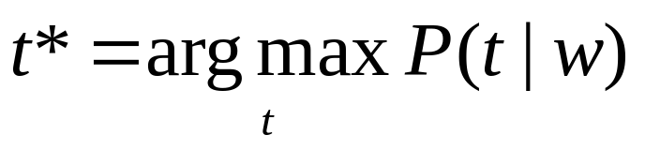
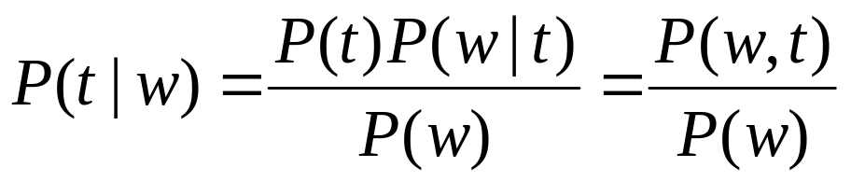


Stochastic Models (Contd..)
Best tag t*,
Bayes Rule gives,
Joint Distribution
Conditional Distribution

Slide 90
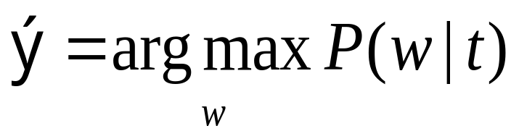
Problem 2: Probabilistic Spell Checker
  w t
  (w_{n}, w_{n-1}, … , w₁) (t_{m}, t_{m-1}, … , t₁)
Noisy Channel
Given t, find the most probable w : Find that ŵ for which P(w|t) is maximum, where t, w and ŵ are strings:
ŵ
Guess at the correct word
Correct word
Wrongly spelt word

Slide 91
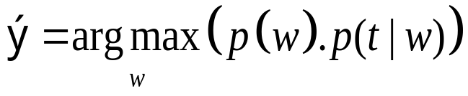
Spell checker: apply Bayes Rule
Why apply Bayes rule?
  Finding p(w|t) vs. p(t|w) ?
p(w|t) or p(t|w) have to be computed by counting c(w,t) or c(t,w) and then normalizing them
Assumptions :
  t is obtained from w by a single error.
  The words consist of only alphabets
ŵ

Slide 92
Spell checker: Confusion Matrix (1/3)
Confusion Matrix: 26x26
Data structure to store c(a,b)
Different matrices for insertion, deletion, substitution and transposition
Substitution
  The number of instances in which a is wrongly substituted by b in the training corpus (denoted sub(x,y) )

Slide 93
Confusion Matrix (2/3)
Insertion
  The number of times a letter y is inserted after x wrongly( denoted ins(x,y) )
Transposition
  The number of times xy is wrongly transposed to yx ( denoted trans(x,y) )
Deletion
  The number of times y is deleted wrongly after x ( denoted del(x,y) )

Slide 94
Confusion Matrix (3/3)
If x and y are alphabets,
  sub(x,y) = # times y is written for x (substitution)
  ins(x,y) = # times x is written as xy
  del(x,y) = # times xy is written as x
  trans(x,y) = # times xy is written as yx

Slide 95
Probabilities from confusion matrix
P(t|w)= P(t|w)_{S} + P(t|w)_{I} + P(t|w)_{D} + P(t|w)_{X}
where
  P(t|w)_{S} = sub(x,y) / count of x
  P(t|w)_{I} = ins(x,y) / count of x
  P(t|w)_{D} = del(x,y) / count of x
  P(t|w)_{X} = trans(x,y) / count of x
These are considered to be mutually exclusive events

Slide 96
Spell checking: Example
Correct document has w_{s}
Wrong document has t_{s}
P(maple|aple)=
  # (maple was wanted instead of aple) / # (aple)
P(apple|aple) and P(applet|aple) calculated similarly
Leads to problems due to data sparsity.
Hence, use Bayes rule.

Slide 97
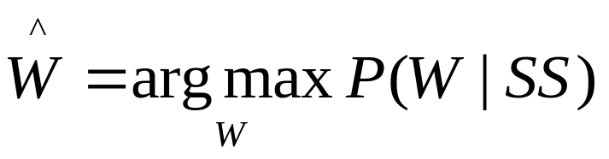
Problem 3: Probabilistic Speech Recognition
Problem Definition : Given a sequence of speech signals, identify the words.
2 steps :
  Segmentation (Word Boundary Detection)
  Identify the word
Isolated Word Recognition :
  Identify W given SS (speech signal)

Slide 98
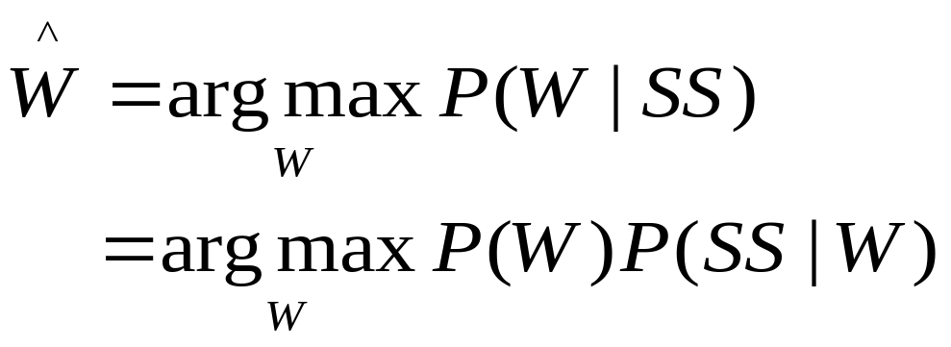
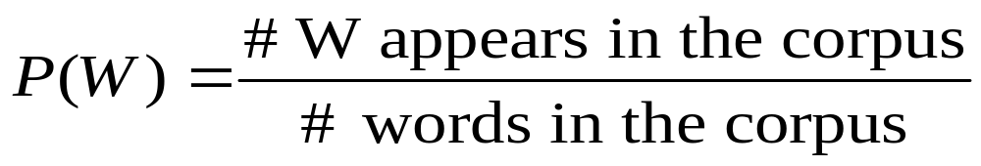
Speech recognition: Identifying the word
P(SS|W) = likelihood called “phonological model “ → intuitively more tractable!
P(W) = prior probability called “language model”

Slide 99
Pronunciation Dictionary
Word
Pronunciation Automaton
s₄
0.73
ae
1.0
1.0
1.0
1.0
1.0
Tomato
t
o
m
t
o
end
0.27
1.0
s₁
s₂
s₃
aa
s₆
s₇
s₅
P(SS|W) is maintained in this way.
P(t o m ae t o |Word is “tomato”) = Product of arc probabilities

Slide 100
Problem 4: Statistical Machine Translation
Source language sentences
Noisy Channel
Target language sentences
What sentence in the target language will maximise the probability
P(target sentence|source sentence)

Slide 101
Statistical MT: Parallel Texts
Observation:
Parallel texts
  Instruction manuals
  Hong Kong legislation
  Macao legislation
  Canadian parliament Hansards
  United nation reports
  Official journal of the European Communities
  Trilingual documents in Indian states
Every time I see banco, the
translation is bank or bench
… if it is banco de, then it
always becomes bank and
never bench
Courtsey: a presentation by K. Knight

Slide 102
SMT: formalism
Source language: F
Target language: E
Source language sentence: f
Target language sentence: e
Source language word: w_{f}
Target language word: w_{e}

Slide 103
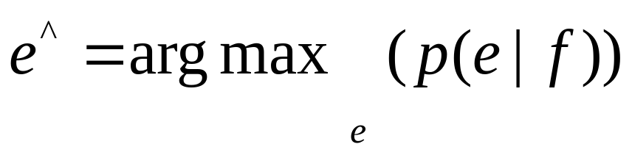
SMT Model
To translate f:
  Assume that all sentences in E are translations of f with some probability!
  Choose the translation with the highest probability

Slide 104
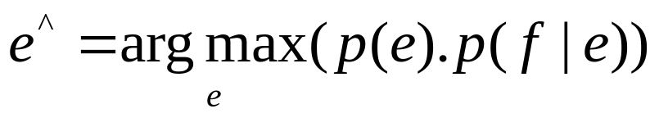
SMT: Apply Bayes Rule
P(e) is called the language model and
stands for fluency
and
P(f|e} is called the translation model and
stands for faithfulness

Slide 105
Reason for Applying Bayes Rule
The way P(f|e) and P(e|f) are usually calculated
  Word translation based
  Word order
  Collocations (For example, strong tea)
Example:
  f: It is raining
  Candidates for e (in Hindi):
    bAriSa Ho raHI HE (rain happening is)
    Ho bAriSa raHI HE (is rain happening)
    bAriSa Ho raHA HE (rain happening_masculine is)

Slide 106
Post-1
POST----5 TITLE: "Wants to invest in IPO? Think again" | <br /><br />Here&acirc;&euro;&trade;s a sobering thought for those who believe in investing in IPOs. Listing gains &acirc;&euro;&rdquo; the return on the IPO scrip at the close of listing day over the allotment price &acirc;&euro;&rdquo; have been falling substantially in the past two years. Average listing gains have fallen from 38% in 2005 to as low as 2% in the first half of 2007.Of the 159 book-built initial public offerings (IPOs) in India between 2000 and 2007, two-thirds saw listing gains. However, these gains have eroded sharply in recent years.Experts say this trend can be attributed to the aggressive pricing strategy that investment bankers adopt before an IPO. &acirc;&euro;&oelig;While the drop in average listing gains is not a good sign, it could be due to the fact that IPO issue managers are getting aggressive with pricing of the issues,&acirc;&euro; says Anand Rathi, chief economist, Sujan Hajra.While the listing gain was 38% in 2005 over 34 issues, it fell to 30% in 2006 over 61 issues and to 2% in 2007 till mid-April over 34 issues. The overall listing gain for 159 issues listed since 2000 has been 23%, according to an analysis by Anand Rathi Securities.Aggressive pricing means the scrip has often been priced at the high end of the pricing range, which would restrict the upward movement of the stock, leading to reduced listing gains for the investor. It also tends to suggest investors should not indiscriminately pump in money into IPOs.But some market experts point out that India fares better than other countries. &acirc;&euro;&oelig;Internationally, there have been periods of negative returns and low positive returns in India should not be considered a bad thing.

Slide 107
Post-2
POST----7TITLE: "[IIM-Jobs] ***** Bank: International Projects Group - Manager"| <br />Please send your CV &amp; cover letter to anup.abraham@*****bank.com ***** Bank, through its International Banking Group (IBG), is expanding beyond the Indian market with an intent to become a significant player in the global marketplace. The exciting growth in the overseas markets is driven not only by India linked opportunities, but also by opportunities of impact that we see as a local player in these overseas markets and / or as a bank with global footprint. IBG comprises of Retail banking, Corporate banking &amp; Treasury in 17 overseas markets we are present in. Technology is seen as key part of the business strategy, and critical to business innovation &amp; capability scale up. The International Projects Group in IBG takes ownership of defining &amp; delivering business critical IT projects, and directly impact business growth. Role: Manager &Acirc;&ndash; International Projects Group Purpose of the role: Define IT initiatives and manage IT projects to achieve business goals. The project domain will be retail, corporate &amp; treasury. The incumbent will work with teams across functions (including internal technology teams &amp; IT vendors for development/implementation) and locations to deliver significant &amp; measurable impact to the business. Location: Mumbai (Short travel to overseas locations may be needed) Key Deliverables: Conceptualize IT initiatives, define business requirements

Slide 108
Sentiment Classification
Positive, negative, neutral – 3 class
Sports, economics, literature - multi class
Create a representation for the document
Classify the representation
The most popular way of representing a document is feature vector (indicator sequence).

Slide 109
Established Techniques
Naïve Bayes Classifier (NBC)
Support Vector Machines (SVM)
Neural Networks
K nearest neighbor classifier
Latent Semantic Indexing
Decision Tree ID3
Concept based indexing

Slide 110
Successful Approaches
The following are successful approaches as reported in literature.
NBC – simple to understand and implement
SVM – complex, requires foundations of perceptions

Slide 111
Mathematical Setting
We have training set
  A: Positive Sentiment Docs
  B: Negative Sentiment Docs
  Let the class of positive and negative documents be C₊ and C₋ , respectively.
  Given a new document D label it positive if
Indicator/feature
vectors to be formed
  P(C₊|D) > P(C₋|D)

Slide 112
Priori Probability
Document | Vector | Classification
D1 | V1 | +
D2 | V2 | -
D3 | V3 | +
.. | .. | ..
D₄₀₀₀ | V₄₀₀₀ | -
Let T = Total no of documents
And let |+| = M
So,|-| = T-M
Priori probability is calculated without considering any features of the new document.
P(D being positive)=M/T

Slide 113
Apply Bayes Theorem
Steps followed for the NBC algorithm:
Calculate Prior Probability of the classes. P(C₊ ) and P(C₋)
Calculate feature probabilities of new document. P(D| C₊ ) and P(D| C₋)
Probability of a document D belonging to a class C can be calculated by Baye’s Theorem as follows:
  P(C|D) = P(C) * P(D|C)
  P(D)
Document belongs to C₊ , if
  P(C₊ ) * P(D|C₊) > P(C₋ ) * P(D|C₋)

Slide 114
Calculating P(D|C₊)
P(D|C₊) is the probability of class C₊ given D. This is calculated as follows:
Identify a set of features/indicators to evaluate a document and generate a feature vector (V_{D}). V_{D} = <x₁ , x₂ , x₃ … x_{n} >
Hence, P(D|C₊) = P(V_{D}|C₊)
= P( <x₁ , x₂ , x₃ … x_{n} > | C₊)
        = |<x1,x2,x3…..xn>, C₊ |
        | C₊ |
Based on the assumption that all features are Independently Identically Distributed (IID)
        = P( <x₁ , x₂ , x₃ … x_{n} > | C₊ )
        = P(x₁ |C₊) * P(x₂ |C₊) * P(x₃ |C₊) *…. P(x_{n} |C₊)
        =∏ _{i=1} ^{n} P(x_{i} |C₊)
P(x_{i} |C₊) can now be calculated as |x_{i} |
|C₊ |

Slide 115
Baseline Accuracy
Just on Tokens as features, 80% accuracy
20% probability of a document being misclassified
On large sets this is significant

Slide 116
To improve accuracy…
Clean corpora
POS tag
Concentrate on critical POS tags (e.g. adjective)
Remove ‘objective’ sentences ('of' ones)
Do aggregation
Use minimal to sophisticated NLP

